Slide 1


Francisco Stigliano
26-April-2023

Slide 2

Outline
Executive Summary
Introduction
Methodology
Results
Conclusion

Slide 3
Executive Summary
Summary of methodologies
Data Collection
Data Wrangling
EDA with data visualization
Building Folium powered interactive maps
Building a Plotly Dash powered Dashboard
Classification predictive analysis
Summary of all results
EDA
Interactive Analysis
Predictive Analysis

Slide 4
Introduction
Project background and context:
Space tourism will be a big thing. Companies must find the way to create the most sustainable way to take people to space. Leading this race is SpaceX with the Falcon 9 Rockets. Each launch costs SpaceX about 62 million dollars a much smaller value when compared with the 165 million dollars that other providers must spend. The reason for the difference? Reusability! The first stage of the rocket can be reused as long as it lands.
Problems you want to find answers
The goal of the project is to predict if the first stage of the SpaceX Falcon9 rocket will land successfully.

Slide 5

Section 1

Slide 6
Methodology
Executive Summary
Data collection methodology:
SpaceX REST API
Web Scrapping from Wikipedia
Perform data wrangling
OHE for Machine Learning and data cleaning of null, nan values and irrelevant collumns
Perform exploratory data analysis (EDA) using visualization and SQL
Perform interactive visual analytics using Folium and Plotly Dash
Perform predictive analysis using classification models
LR, KNN, SVM and DT models were built, trained and evaluated

Slide 7
Data Collection
Sources
Wikipedia Web Scraping Using BeautifulSoup
Information provided by the SpaceX REST API
Launches
Rocket Used
Payload Delivered
Launch and Landing info
Landing Outcome (if it landed or if an unscheduled rapid disassembly happened)

Slide 8
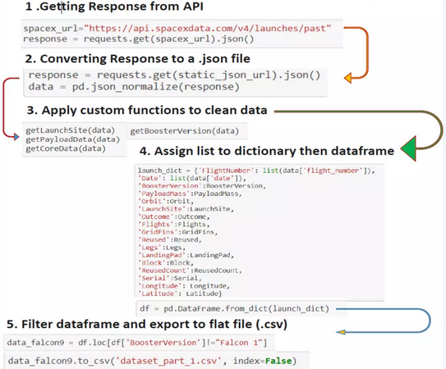
Data Collection – SpaceX API
SpaceX REST API for Data Collection
GitHub - SpaceX API requests

Slide 9
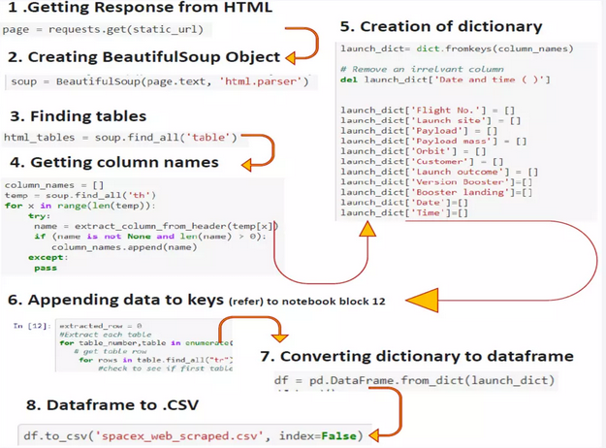
Data Collection - Scraping
Web Scraping Wikipedia pages
Github - WebScraping

Slide 10
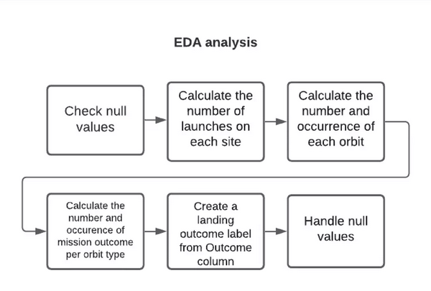
Data Wrangling
Github - Data Wrangling

Slide 11
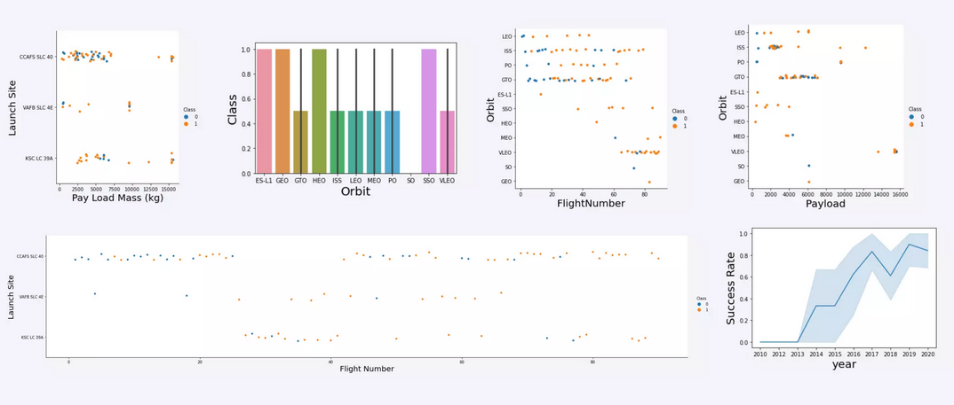
EDA with Data Visualization
Github- Viz

Slide 12
EDA with SQL
Some queries performed:
Displaying singular and combined categories
Listing the successful events
Ranking the outcomes on a given interval
Github - SQL

Slide 13
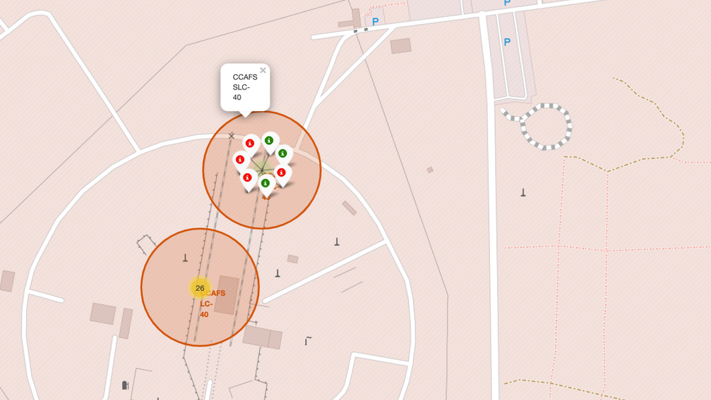
Build an Interactive Map with Folium
Github - Folium

Slide 14
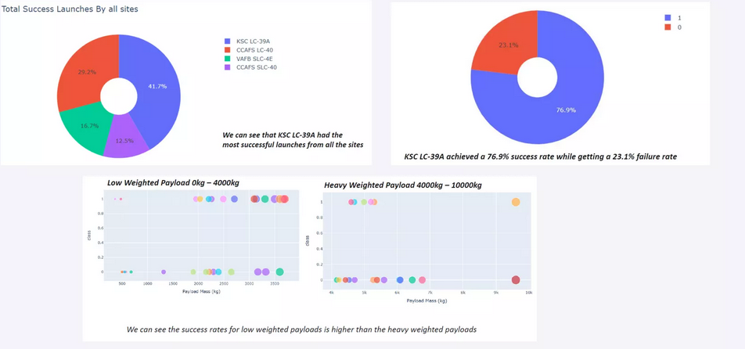
Build a Dashboard with Plotly Dash
Github - Plotly Dash

Slide 15
Predictive Analysis (Classification)
Both the SVM and the KNN got an accuracy score of 83.3%, the highest amongst the 4 models trained.
The SVM also has the best under the curve performance at 0.958
Github - Machine Learning

Slide 16
Results
SVM, KNN and LR work well in terms of accuracy
Heavy payloads generally landing to fail
The success rate of launches and landings as risen throughout the years
Orbit GEO,HEO,SSO,ES L1 has provides the best rate for sucess

Slide 17

Section 2

Slide 18
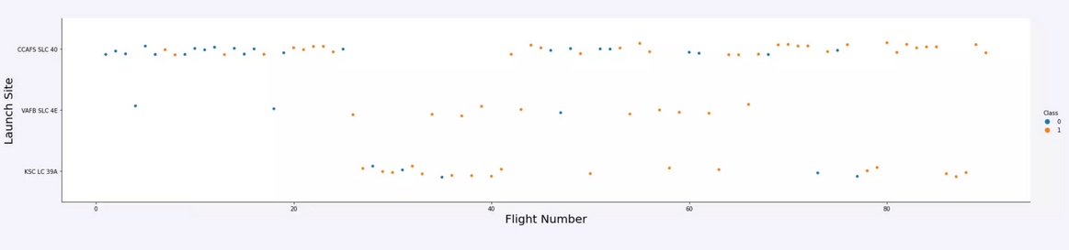
Flight Number vs. Launch Site
CCAFS SLC 40 Launches have the best performance

Slide 19
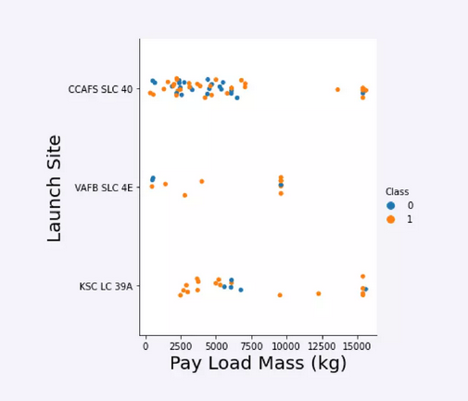
Payload vs. Launch Site
Showing the correlation between launch Site and the payload mass

Slide 20
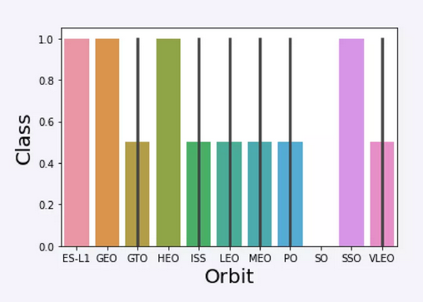
Success Rate vs. Orbit Type
Success rate of each orbit

Slide 21
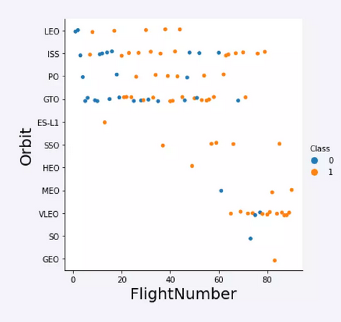
Flight Number vs. Orbit Type
Types of orbit for each flight number.

Slide 22
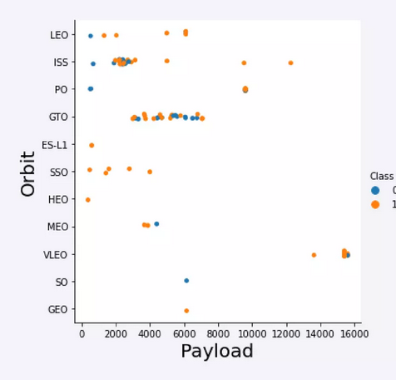
Payload vs. Orbit Type
A scatter plot that explain the relationship between the payload mass and the orbit chosen

Slide 23
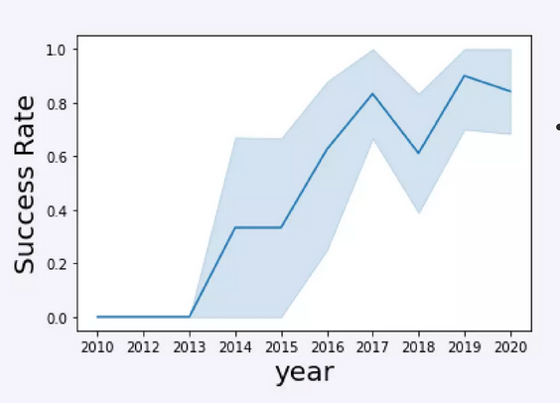
Launch Success Yearly Trend
Launch success has experienced an uprising trend throughout the years

Slide 24
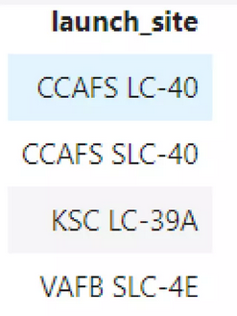
All Launch Site Names
Find the names of the unique launch sites
%sql select distinct(LAUNCH_SITE) from SPACEXTBL

Slide 25
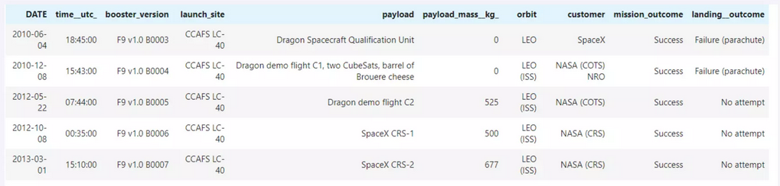
Launch Site Names Begin with 'CCA'
Find 5 records where launch sites begin with `CCA`
%sql select * SPACEXTBL where LAUNCH_SITE like ‘CCA%’ limit 5

Slide 26
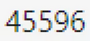
Total Payload Mass
Total payload carried by boosters from NASA
% select sum(PAYLOAD_MASS_KG_) from PACEXTBL where CUSTOMER = NASA (CRS)

Slide 27
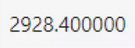
Average Payload Mass by F9 v1.1
Average payload mass carried by booster version F9 v1.1
%sql select avg(PAYLOAD_MASS_KG_) from SPACEXTBL where BOOSTER_VERSION = ‘F9 v1.1’

Slide 28
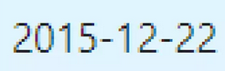
First Successful Ground Landing Date
Dates of the first successful landing outcome on ground pad
%sql select min(DATE) from SPACEXTBL where Landing_Outcome 0 ‘Success (ground pad)’

Slide 29
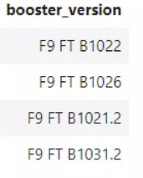
Successful Drone Ship Landing with Payload between 4000 and 6000
Names of boosters which have successfully landed on drone ship and had payload mass greater than 4000 but less than 6000
%sql select BOOSTER_VERSION from SPACEXTBL where Landing_Outcome = ‘Success (drone ship)’ and PAYLOAD_MASS_KG_ > 4000 and PAYLOAD_MASS_KG_< 6000

Slide 30

Total Number of Successful and Failure Mission Outcomes
Total number of successful and failure mission outcomes
%sql select count(MISSION_OUTCOME) from SPACEXTBL where MISSION_OUTCOME = ‘Success’ or MISSION_OUTCOME = ‘Failure (in flight)’

Slide 31
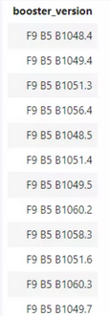
Boosters Carried Maximum Payload
Names of the booster which have carried the maximum payload mass
%sql select BOOSTER_VERSION from SPACEXTBL where PAYLOAD_MASS_KG_ = (select max(PAYLOAD_MASS_KG_) from SPACEXTBL)

Slide 32
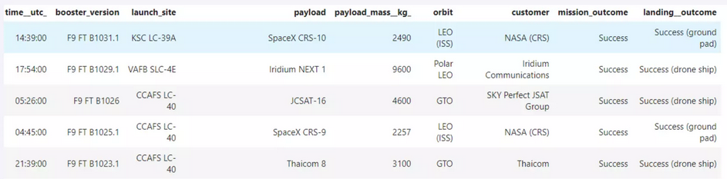
2015 Launch Records
Failed landing_outcomes in drone ship, their booster versions, and launch site names for in year 2015
%sql select* from SPACEXTBL where Landing_Outcome like ‘Success%’ and (DATE between ‘2015-01-01’ and ‘2015-12-31’) order by date desc

Slide 33
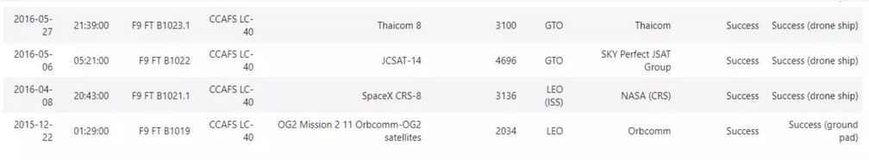
Rank Landing Outcomes Between 2010-06-04 and 2017-03-20
Ranking the count of landing outcomes (such as Failure (drone ship) or Success (ground pad)) between the date 2010-06-04 and 2017-03-20, in descending order
%sql select* from SPACEXTBL where Landing_Outcome like ‘Success%’ and (DATE between ‘2010-06-04’ and ‘2017-03-20’) order by date desc

Slide 34

Section 3

Slide 35
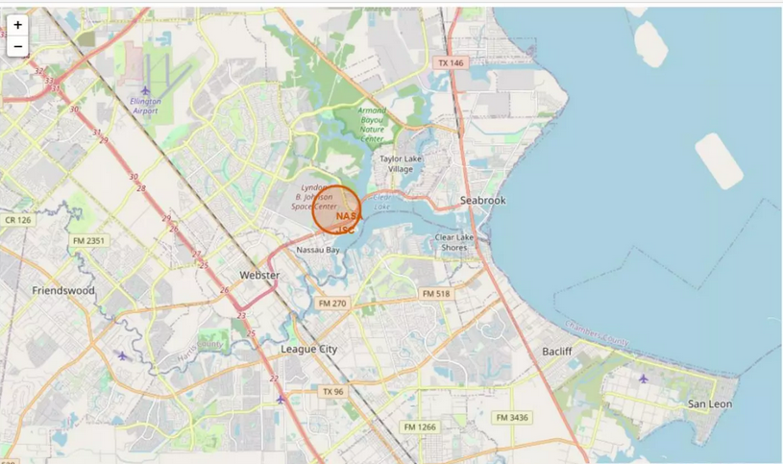
Launch Site Location

Slide 36
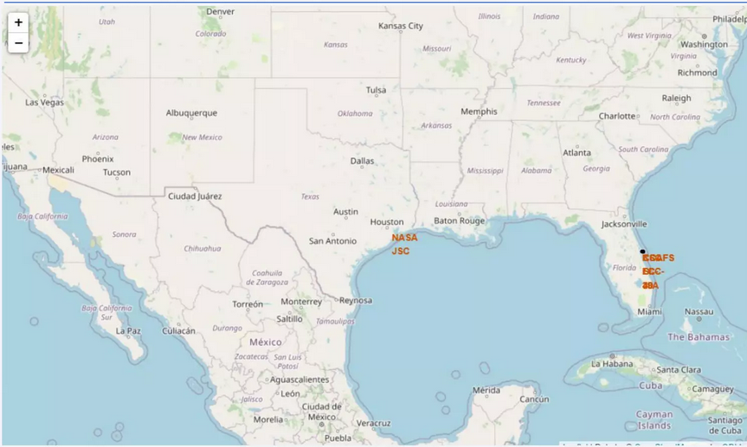
Successful vs Unsuccessful launches on a map

Slide 37

Distances from launch site to proximities

Slide 38

Section 4

Slide 39
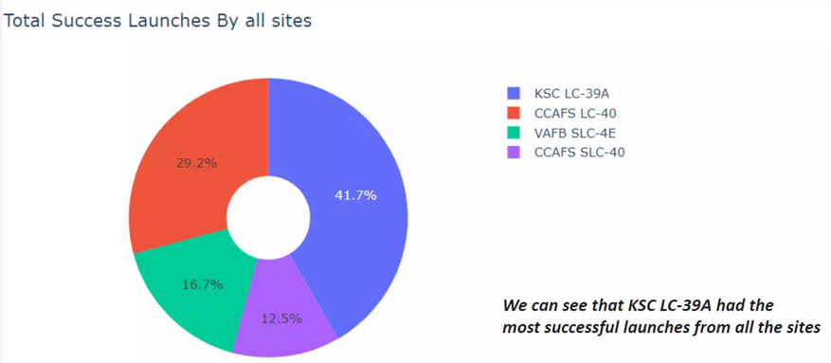
Success Percentages by Launch Site

Slide 40
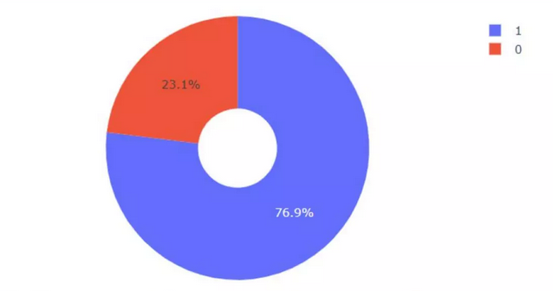
Success Rate by Site

Slide 41
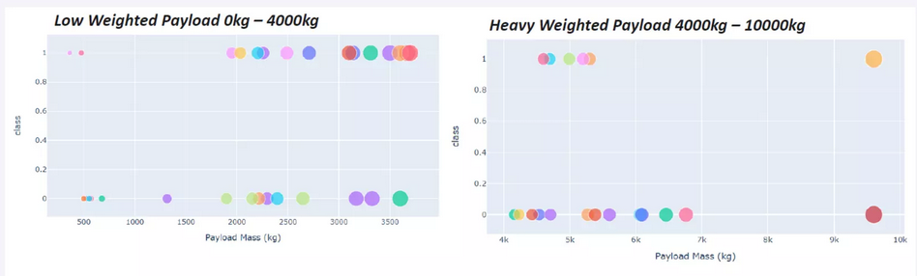
Payload Mass vs Outcome

Slide 42

Section 5

Slide 43
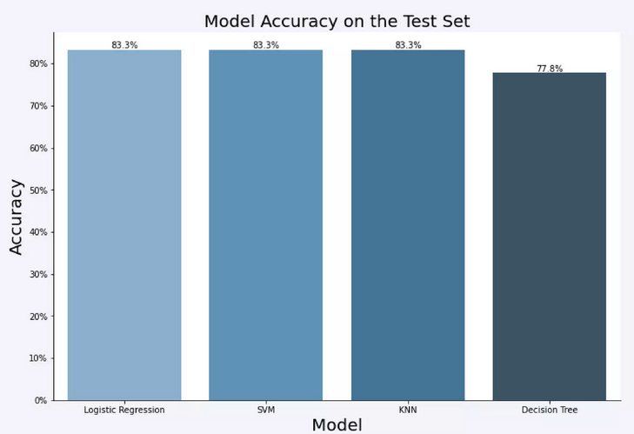
Classification Accuracy

Slide 44
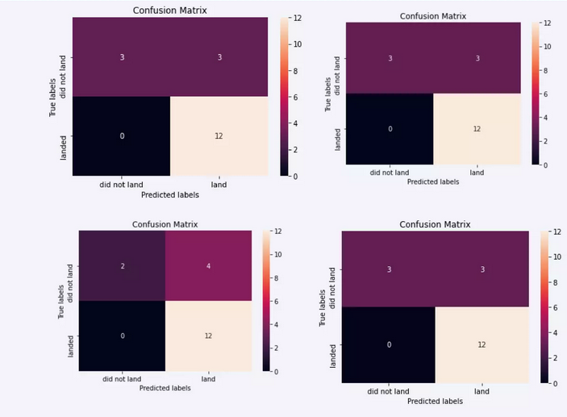
Confusion Matrix

Slide 45
Conclusions
SVM, KNN and LR can all be used to predict the landing outcome with the same accuracy
Heavier Payloads generally perform worse than lighter ones
The success of SpaceX Landings has been increasing throughout the years
Some launch sites have better performance, such as the KSC LS 39A. This might be because sites like this generally are used for launches with lighter payloads
Some orbits like the GEO,HEO,SSO,ES L1 have better rates than other, the reasons for these orbital differences were not studied.

Slide 46


